Slide 1
Secure Data Hiding in images using steganography
CAPSTONE PROJECT
Presented By:
Student Name: Isha More
College Name & Department: ZCOER Computer Science

Slide 2
OUTLINE
Problem Statement
Technology used
Wow factor
End users
Result
Conclusion
Git-hub Link
Future scope

Slide 3
Problem Statement
Develop a Python-based image steganography system to:
Hide a secret message in an image
Securely retrieve the message using a passcode
Prevent unauthorized access

Slide 4
Technology used
Technology | Purpose
Python | Core programming language
OpenCV (cv2) | Image processing (read, modify, save images)
OS Module | Open saved encrypted images
String Manipulation | Encoding/decoding messages
Dictionary Data Structure | Character-to-pixel mapping
Basic Cryptography | Passcode-based message retrieval

Slide 5
Wow factors
This project stands out due to its dual-layer security, combining AES-256 encryption with image steganography, ensuring hidden messages remain highly secure and undetectable. The invisible data embedding technique modifies pixel values without noticeable visual changes, making it perfect for covert communication.
Additionally, the passcode-protected decryption adds an extra layer of authentication, preventing unauthorized access. Future upgrades include a GUI-based interface using Tkinter or PyQt for better usability and video steganography, allowing messages to be hidden within video frames.
Another impressive aspect is metadata-based steganography, where messages are concealed in EXIF data instead of pixels, making them even harder to detect. To push innovation further, integrating AI-powered deep learning models like Autoencoders or GANs could enhance security and efficiency.
With applications in cybersecurity, intelligence, journalism, corporate security, and forensics, this project is a powerful and practical tool for secure information exchange in the digital age.

Slide 6
End users
🔹 Cybersecurity Professionals – Secure communication and data protection against cyber threats.
🔹 Government & Intelligence Agencies – Covert messaging and secure transmission of sensitive information.
🔹 Journalists & Whistleblowers– Hide messages to communicate securely in high-risk environments.
🔹 Corporate & Business Organizations – Protect confidential data and prevent industrial espionage.
🔹 Forensic Experts – Digital watermarking and data authentication in cybersecurity investigations.
🔹 Developers & Researchers– Explore new advancements in steganography for improved security techniques.
🔹 General Users – Individuals who want to protect personal data in a visually hidden format.

Slide 7
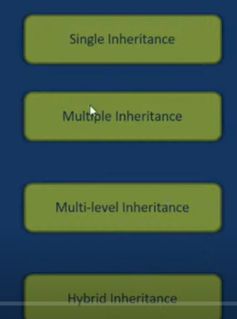
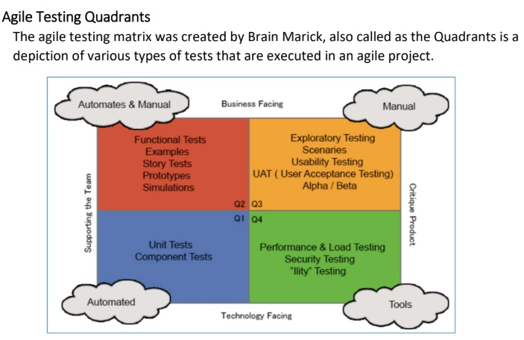
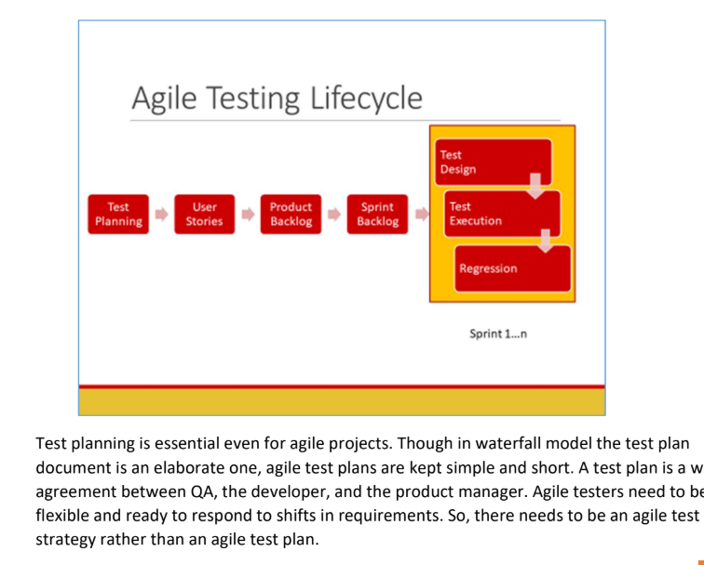
Results

Slide 8
Conclusion
This project showcases the power of image steganography in securely hiding and retrieving messages using encryption and pixel manipulation.
With passcode protection and future enhancements like GUI integration, video steganography, and metadata embedding, it offers a robust and user-friendly solution.
Its applications in cybersecurity, intelligence, and digital forensics make it a valuable tool for secure communication in the digital age.

Slide 9
GitHub Link
https://github.com/Ishha9/Stegnography_AI

Slide 10
Future scope(optional)
Implement AES Encryption – Before embedding the message in the image, encrypt it using AES-256 to enhance security and prevent unauthorized extraction.
Use Deep Learning for Steganography – Implement Autoencoders or GANs (Generative Adversarial Networks) to create a more robust and undetectable steganographic method for hiding messages in images.
Embed Messages in Image Metadata (EXIF Data) – Instead of altering pixel values, store the secret message within the EXIF metadata of images, making it less detectable and preserving image quality.
Develop a User-Friendly GUI with Tkinter or PyQt – Instead of a command-line interface, create a graphical user interface (GUI) using Tkinter or PyQt to make encryption and decryption more accessible for non-technical users.
Support for Video Steganography – Extend the system to hide messages inside video frames instead of just static images, making it applicable for more secure multimedia communication.
Multi-Layer Steganography – Combine multiple hiding techniques, such as embedding messages in both pixel values and metadata, to increase security and make detection more challenging.This detailed version makes the future enhancements clearer and actionable for potential improvements! 🚀🔒

Slide 11
THANK YOU

